Slide 1
The Linkage of Chinese Stock Market to US and UK before and after the Subprime Mortgage Crisis
Young-Jae Kim and Li Ying
(Pusan National University)

Slide 2
Contents
Motivations and Backgrounds
Purposes
Differences
Empirical Analysis
Main Results
2/15

Slide 3
1. Motivations and Backgrounds
The rapid rising of Chinese economy after the 2008 global financial crisis
: So-called G2
The global effects of subprime mortgage crisis in 2007
Possible integration of Chinese stock market to the global market
: US and UK
3/15

Slide 4
2. Purposes
To investigate the expected correlation of market volatility among the three stock markets
: US, UK and China
To show the possible shift in the correlation of market volatility before and after the 2007 Subprime mortgage crisis: Strengthened correlations
4/15

Slide 5
3. Differences
Very few papers that consider the Chinese stock market in relation to the US and UK markets
Explicit incorporation of subprime mortgage crisis
Advanced econometric model
5/15

Slide 6
4. Empirical Analysis
Sample period : Jan. 2, 2002 to Jan. 18 2010
Data : S&P 500 in US, FTSE in UK, Shanghai Composite Index in China from Datastream
Structural Change : Sep. 2, 2008
Before crisis period : Jan. 2 – Sep. 2, 2008
After crisis period : Sep. 3, 2008 – Jan. 18,
2010
6/15

Slide 7
Chow Test
 | F-statistic | Prob.
US | 4.703010 | 0.0028
UK | 27.03530 | 0.0000
China | 3.695460 | 0.0011
7/15

Slide 8
Key Variables
 | Law Series | Return Series
US | USA = S&P500 | DLUSA = Δln(USA)
UK | UK = FTSE100 | DLUK=Δln(UK)
China | SH = Shanghai Composite Index | DLSH =Δln(SH)
8/15

Slide 9
The Model
Multivariate GARCH-Diagonal VECH Model
(by Engle and Kroner (1995))
Mean Equation
Variance Equation
Covariance Equation
9/15

Slide 10
Basic Statistics for Key Variables
is a normally distributed
Yt | Mean | Std,Dev. | Skewness | Kurtosis | JB statistic | P-value
A. Before crisis
DLUSA | 6.15e-05 | 0.010615 | 0.104969 | 5.350615 | 318.5083 | 0.000000
DLUK | 4.52e-05 | 0.011531 | -0.148691 | 6.762943 | 976.0003 | 0.000000
DLSH | 0.000205 | 0.017212 | -0.152913 | 7.224792 | 1229.059 | 0.000000
B. After crisis
DLUSA | -0.000368 | 0.025980 | -0.431795 | 7.701759 | 303.7454 | 0.000000
DLUK | -9.36e-05 | 0.022370 | -0.243936 | 7.584366 | 282.5058 | 0.000000
DLSH | 0.001065 | 0.022669 | -0.062646 | 4.368923 | 25.11659 | 0.000004
10/15

Slide 11
Autocorrelation : Ljung-Box Q test
is not serially correlated ⇔ :
Test for Stock Returns Q(k)
 | Q(4) | Q(19) | Q(36)
A. Before crisis
DLUSA | 13.507(0.009) | 42.476(0.002) | 66.023(0.002)
DLUK | 48.153(0.000) | 85.623(0.000) | 134.99(0.000)
DLSH | 10.357(0.035) | 27.929(0.085) | 53.226(0.032)
B. After crisis
DLUSA | 18.516(0.001) | 38.511(0.005) | 59.455(0.008)
DLUK | 23.143(0.000) | 73.850(0.000) | 92.186(0.000)
DLSH | 1.0784(0.898) | 15.579(0.685) | 37.864(0.384)
11/15

Slide 12
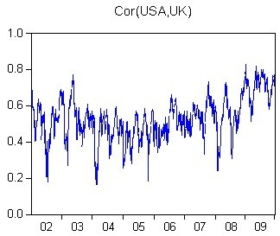
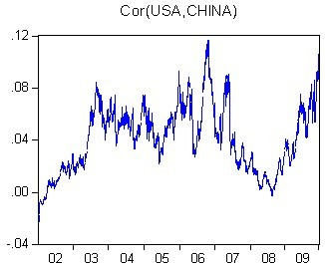
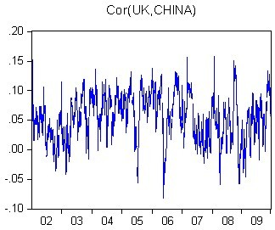
Conditional Correlation: Entire Period
<Figure 4-1>
15/15

Slide 13
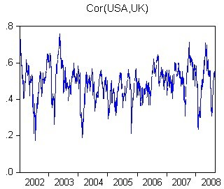
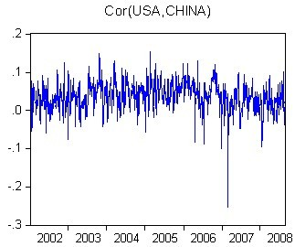
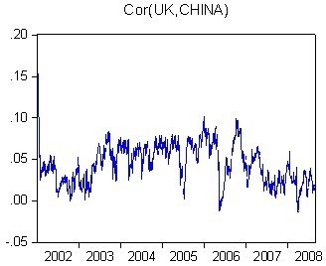
Conditional Correlation: Before crisis
<Figure 4-2>
12/15

Slide 14
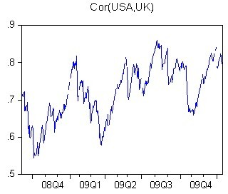
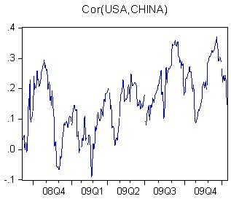
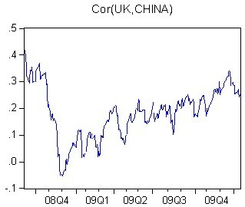
Conditional Correlation: After crisis
<Figure 4-3>
13/15

Slide 15
5. Main Results
Correlations between China and US, between China and UK have increased after the crisis, which means the Chinese stock market becomes a part of the global market reflecting the rapidly rising Chinese economy.
14/15

